Slide 2
Rheumatoid Arthritis A to Z
Candace Ryan, PA-C
Arizona Arthritis and Rheumatology Associates

Slide 3
Disclosure Policy
All individuals in control of the content of continuing education activities provided by the Annenberg Center for Health Sciences at Eisenhower (ACHS) are required to disclose to the audience all relevant financial relationships related to the content of the presentation or enduring material. Full disclosure of all relevant financial relationships will be made in writing to the audience prior to the activity. All other staff at the Annenberg Center for Health Sciences at Eisenhower and RhAPP have no relationships to disclose.

Slide 4
Financial Disclosures
Speaker: Sanofi Genzyme

Slide 5
Objectives:
Feel comfortable diagnosing Rheumatoid Arthritis ( RA) based on ACR/Eular criteria.
Be able to identify the inflammatory process associated with the development of RA.
Determine the difference between RA and OA.
Learn about the most common extraarticular manifestations of RA.
Be aware of the different instruments available for measuring RA disease activity and be able to interpret their scores.
Go through a standard RA treatment algorithm.

Slide 6
What Is RA?
A chronic, systemic, inflammatory disease of joints that is characterized by its pattern of joint involvement.
In the majority of cases, there is serum elevations of autoantibodies that include RF and CCP.
The primary site of pathology is the synovium of the joint.
The synovial tissue becomes inflamed and proliferates, forming pannus that invades bone, cartilage, and ligaments and leads to damage and deformities.

Slide 7
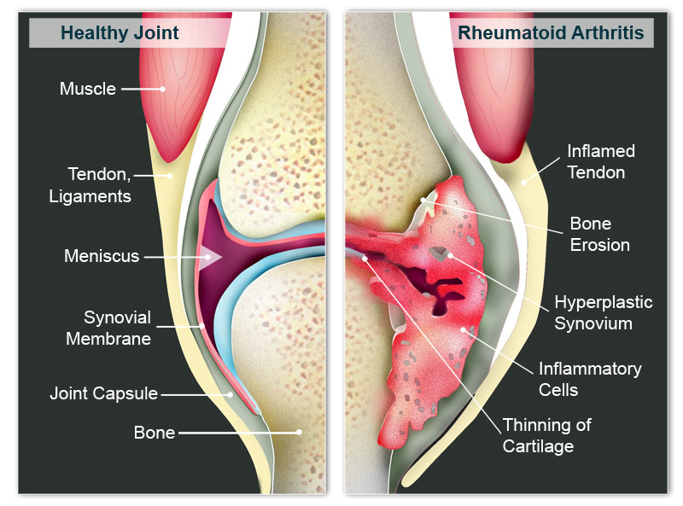

Slide 8
Etiology and Pathogenesis
The exact etiology remains unknown, but its likely multifactorial with both genetics and environmental factors both playing roles.
Antibodies can be found in the blood several years before the development of joint inflammation.
GENETICS:
Twin studies show that the concordance rate for RA is 12-15% in monozygotic twins and 2-3% in fraternal twins. General population 1%.
80-90% of all RA is sporadic, occurring in individuals with no Fhx.
ENVIRONMENTAL:
Cigarette exposure increases the odds ration for SPRA, 21-fold.
Other inhaled factors: Air Pollution and Silica dust.
Viruses: Epstein–Barr virus and Parvovirus have been associated w/ RA.
Bacteria: microbiomes of mucosal sites.

Slide 9
2010 ACR/EULAR Classificaton Criteria

Slide 10
Differential Diagnoses
Seronegative Spondyloarthropathies
Calcium Pyrophosphate Deposition Disease ( CPPD)
CTD/ SLE
Osteoarthritis
Viral Infection (EBV, Hepatitis C, HIV, Hepatitis B, Parvovirus.)
Polyarticular Gout
Fibromyalgia
Reactive Arthritis
PEARL: A diagnosis other than RA should be considered in patients who have an asymmetric arthritis, migrating pattern, predominantly large-joint arthritis, DIP joint involvement, rashes, renal disease, or leukopenia.

Slide 11
Epidemiology
Occurs in 1% of adults in the United States
Sex distribution: Females > Males 2-3:1
Age: Avg age 40-60, men are older
Race: Worldwide, all races
Algonquian and Pima Indians have higher Prevalence

Slide 12
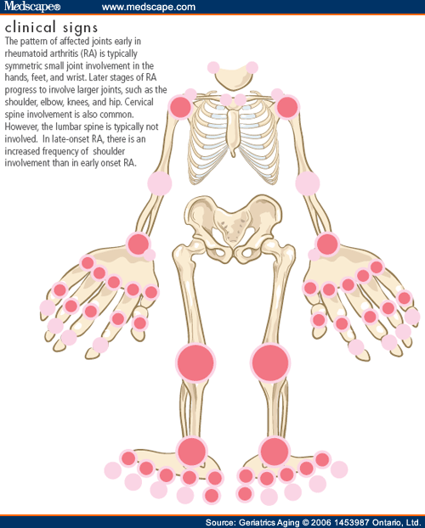
Most Common Joints Involved

Slide 13
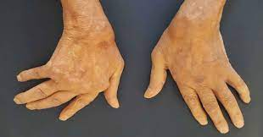
Common Deformities of the Hands

Slide 14
RA and the Feet
In some patients, the feet may be the first manifestation of RA.
MTP squeeze test, where the forefoot is squeezed by the examiner’s hand, may provide a clue to synovitis if there is tenderness in any of the MTPs.
Most common deformity: The Hammer Toe which is caused by subluxation of the metatarsal heads.
Pts commonly complain that it feels as if they are walking on marbles.

Slide 15
Radiographic Features of RA
Mnemonic ABCDE’S
Alignment – Abnormal; no ankylosis
Bones – Periarticular Osteopenia; no periostitis or osteophytes
Cartilage – Symmetric joint space loss in weight- bearing joints; no cartilage or soft tissue calcification
Deformities – (swan neck, ulnar deviation, boutonniere) with -symmetrical distribution
Erosions – Marginal
Soft Tissue Swelling; nodules without calcification

Slide 16
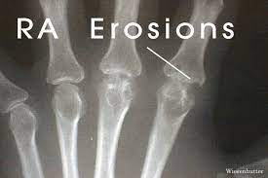
Marginal Erosion

Slide 17
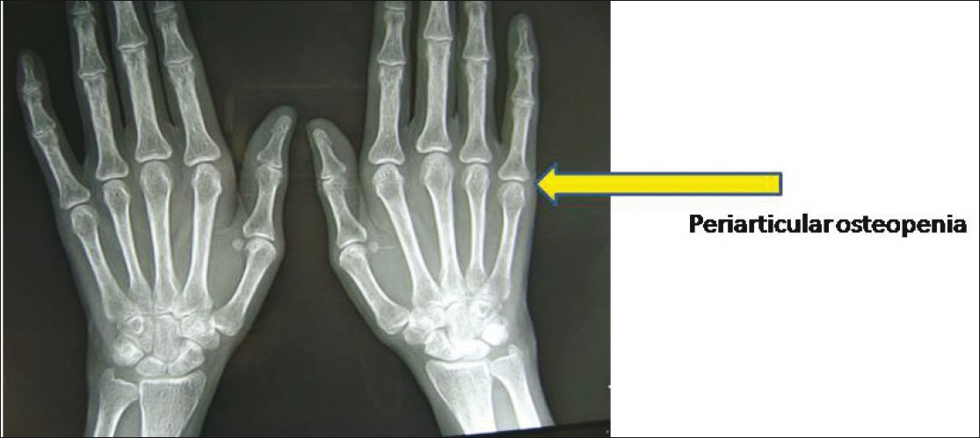
Periarticular Osteopenia

Slide 18
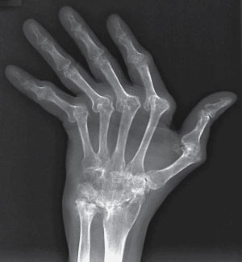
Ulnar Deviation

Slide 19
RA vs OA
 | Rheumatoid Arthritis | Osteoarthritis
Sclerosis | +/- | ++++
Osteophytes | +/- | ++++
Osteopenia | +++ | 0
Symmetry | +++ | +
Marginal Erosions | +++ | 0
Cysts | ++ | ++
Narrowing | +++ | +++

Slide 20
Synovial Fluid Analysis
Table 1. Synovial Effusions with Associated Laboratory Findings
Synovial Effusions | Causes | Color | Viscosity | WBC Count; % neutrophils
Normal synovial fluid |  | Clear | High | <150 cells/µL <25% polys
Osteoarthritis | Degenerative joint disease | Clear | High | 200-2,000/µL <30% polys
Crystal-induced arthritis | Gout Pseudogout | Cloudy | Variable | 2,000-50K/µL 50-90% polys
Autoimmune arthritis | SLE; Rheumatoid arthritis | Cloudy | Variable | 2,000-50K/µL 50-90% polys
Septic arthritis | Staph aureus N. gonorrhea | Yellow-green or milky | Low | >50,000/µL ≥90% polys
Hemorrhage | Hemophilia; Trauma; Anticoagulant Rx | Red-brown
**Note: neutrophils = polys

Slide 21
Cervical Involvement in RA
The C Spine is involved in 30-50% of RA patients with C1-C2 most commonly involved.
Arthritic involvement can lead to instability with potential impingement of the spinal cord; thus it is important to obtain XRs of the C Spine before surgical procedures that require intubation.
The earliest/ most frequent symptom of subluxation is pain radiating to the occiput.
C1-C2 subluxation (60-65% of cases) – anteriorly being the most common and posteriorly being the least common.
The risk of cord compression is greatest when the anterior atlantoodontoid interval is > 8 or the posterior interval is <15.
C1-C2 Impaction (20-25% of cases)
Subaxial Involvement (10-15% of cases)

Slide 22
Typical Lab Findings in RA Patients
CBC – Anemia of chronic disease and thrombocytopenia.
Chemistries – Albumin may be low in active disease.
Urinalysis – Normal
Erythrocyte Sedimentation Rate (ESR) – Usually elevated.
C-Reactive Protein (CRP) – Usually elevated. More ideal than ESR. Not affected by Hypergammaglobulinemia.
Anti-cyclic citrullinated peptide (CCP)- 57-67% with specificity 93-99%.
Rheumatoid Factor (RF) – Positive 60-80% with specificity 80-86% ( for RA).
Several diseases with arthritis can have a + RF 1) Hep C (40-75%) 2) SLE (20%) 3) Sjogren’s Syndrome (70%), TB (60%), subacute bacterial endocarditis (45-68%).
Antinuclear Antibodies (ANA) – 30-50%
Novel Autoantibodies – Anti-CarP and 14-3-3 eta.

Slide 23
Extraarticular Manifestations of RA

Slide 24
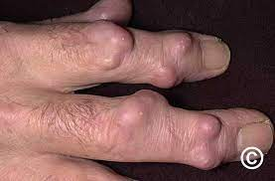
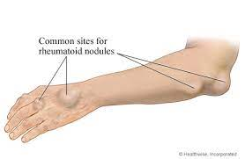
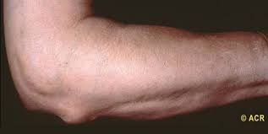
Rheumatoid Nodules
Occur in 20-35% of RA patients who are typically have a +RF and severe disease activity.
They frequently develop and enlarge when disease is active and may resolve when disease activity is controlled.

Slide 25
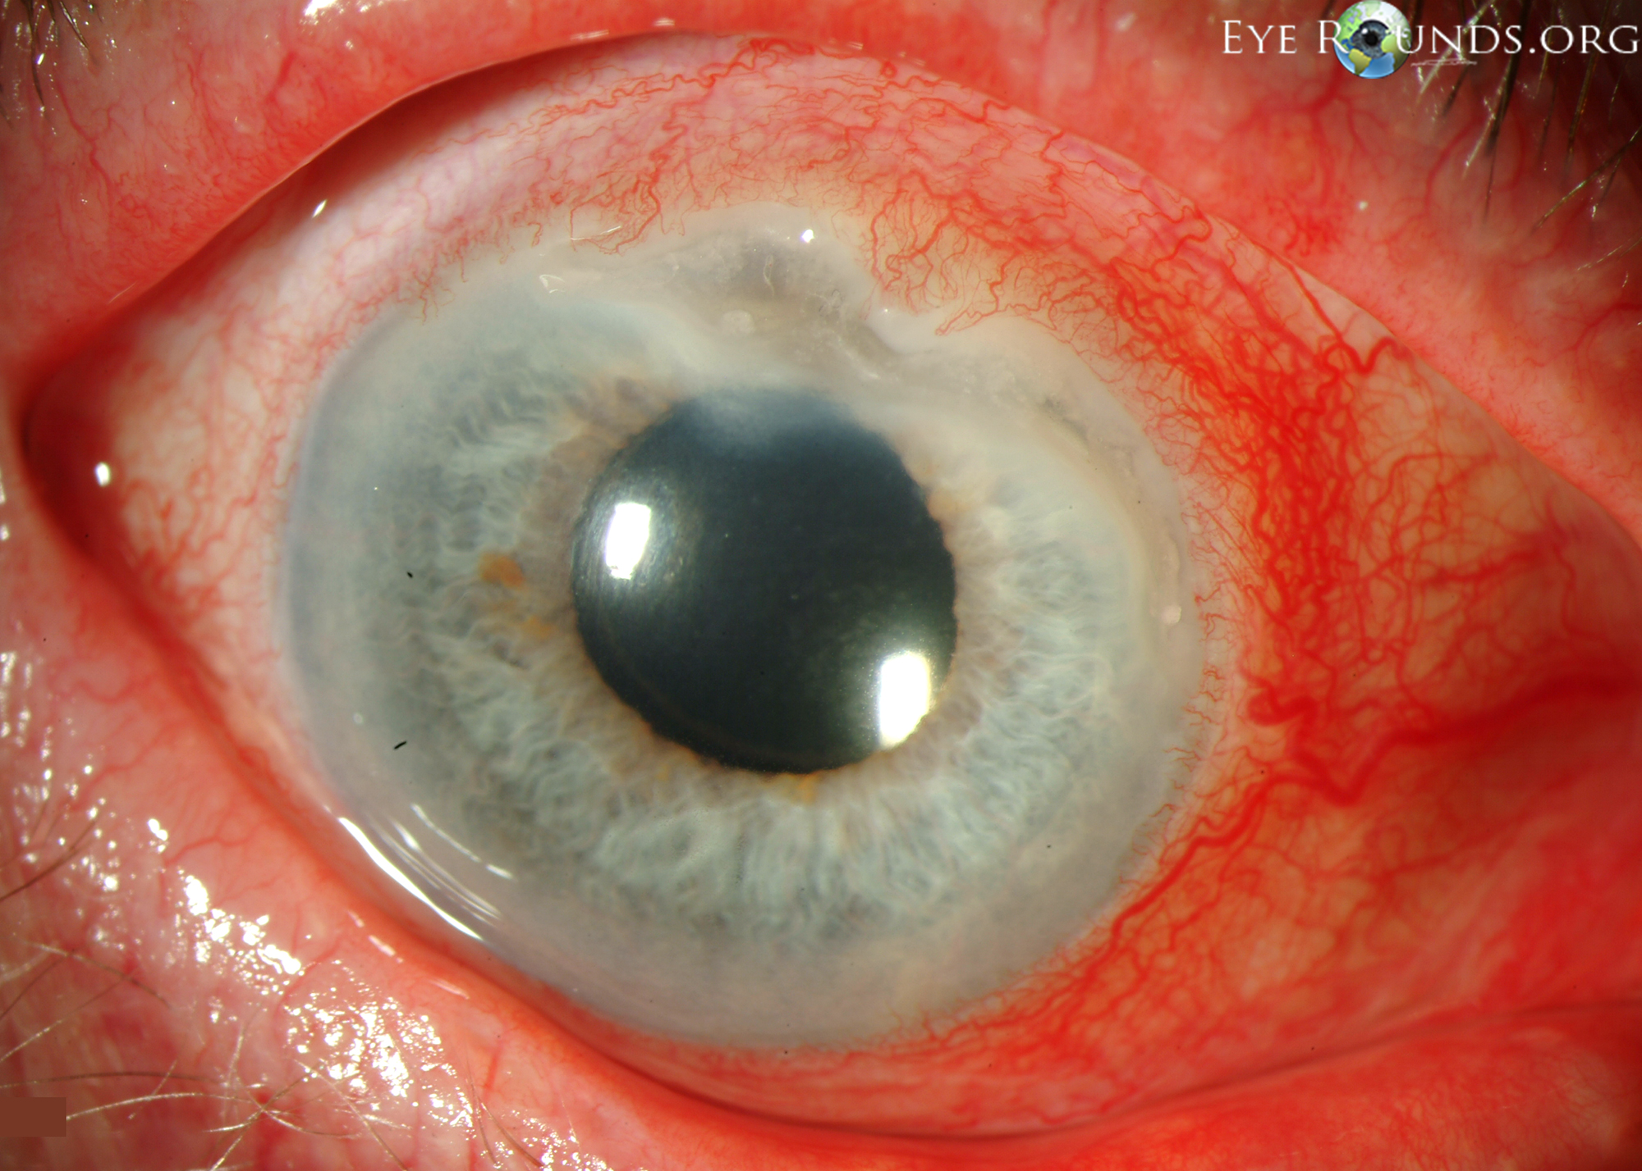
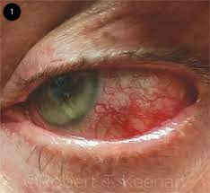
Ocular Manifestations
Both Episcleritis and scleritis can occur in RA patients ( < 1%).
Corneal Melt is rare but severe and blinding – requires aggressive immunosuppression.
Sicca Symptoms of dry eye frequently accompany coexistent Sjogren’s.

Slide 26
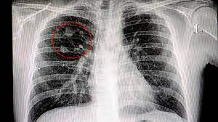
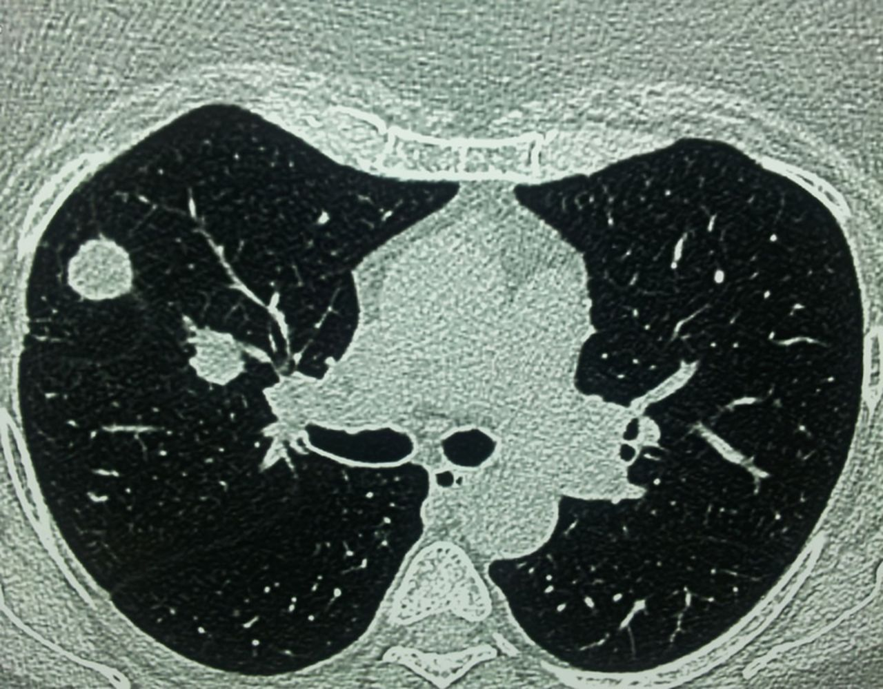
Pulmonary Manifestations
Pleural Diseases: Pleurisy and Pleural Effusions (typically unilaterally) occur commonly but are symptomatic in < 5%
Pleural Effusions are characterized as cellular exudates (high protein & lactate dehydrogenase levels, and low glucose and pH levels.
Nodules: may be solitary or multiple and can cavitate or resolve spontaneously
Caplan’s Syndrome: multiple nodules occurring in the lungs of coal miners with RA. Cancer needs to be ruled out.
Interstitial Lung Disease (ILD): occurs commonly, but symptomatic in < 10%. RA-ILD is most common in males and smokers. Primarily involves the lower lobes.

Slide 27
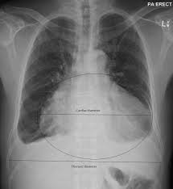
Cardiac Manifestations
Pericarditis * (most common) | Pain ( 1%)
 | Tamponade (rare)
 | Constriction ( uncommon)
Nodules | Conduction abnormalities
 | Valvular problems
Coronary Arteritis | Myocardial Infarction ( MI)
Myocarditis | Congestive Heart Failure

Slide 28
Felty’s Syndrome Fun Facts
1% of patients with Rheumatoid Arthritis
95% are RF positive
13 fold increase risk of developing non-Hodgkin’s lymphoma
Treatment is the same for RA patients with joint disease and can include Methotrexate or DMARD therapy
Splenectomy is reserved for patients with severe, recurrent bacterial infections or patients with chronic non-healing ulcers who are not responsive to or tolerant to drug therapy

Slide 29
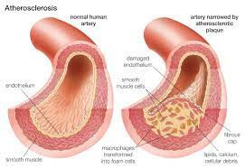
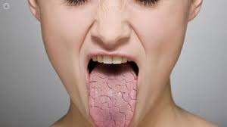
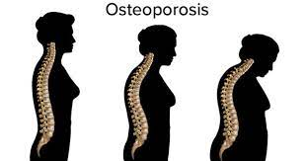
Clinical Problems
Atherosclerosis: Developed 10 years earlier than those without RA, but have the same traditional risk factors.
Sjogren’s Syndrome: 20-30% of RA patients develop secondary Sjogren’s with dry eyes and dry mouth. SSA/ SSB are usually negative.
Osteoporosis: Seen in the majority of RA patients, related to disease activity, immobility, and medications.
Entrapment Neuropathy: Median Nerve (Carpal Tunnel Syndrome), Posterior Tibial Nerve (Tarsal Tunnel), Ulnar Nerve (Cubital Tunnel).
Laryngeal Manifestations: dysphasia, hoarseness, and strider.
Ossicles of the Ear: tinnitus and decreased hearing.

Slide 30
Instruments to Measure RA Disease Activity
The most important thing is to pick one and USE IT!
DAS28 (28 joints): DAS Calculator using TJC, SJC, ESR, and PtGA.
SDAI: TJC (0-28) + SJC (0-28) + PtGA (0-10) + PhGA (0-10) + CRP
CDAI: TJC (0-28) + SJC (0-28) + PtGA (0-10) + PhGA (0-10)
RAPID3: MDHAQ (0-10) + Patient Pain (1-10) + PtGA (0-10)
www.das-score.nl
MDHAQ = Multidimensional health assessment questionnaire.

Slide 31
Classification of Disease Activity
Instrument (Score Range) | Remission | Low Disease Activity | Moderate Disease Activity | Severe Disease Activity
DAS28-ESR (0-9.4) | <2.6 | ≥2.6 and ≤3.2 | >3.2 to ≤5.1 | >5.1
SDAI (0-86) | ≤3.3 | >3.3 and ≤11.0 | >11 to ≤26 | >26
CDAI (0-76) | ≤2.8 | 2.8 and ≤10 | >10 to ≤22 | >22
RAPID3 (0-30) | >0 and ≤1.0 | >1.0 and ≤6 | >6 to ≤12 | >12

Slide 32
Predicting Poor Prognosis
Long disease duration prior to treatment
+RF and + CCP
Poor functional status (HAQ score > 1)
>13 Joint involved
Extraarticular disease, especially nodules
Persistently elevated ESR or CRP
ANA positivity (if RF is positive)
Radiographic erosions within 2 years of disease onset
Low education level

Slide 33
Goals for Treatment
Treat early: The best results are seen when RA patients are started on therapy within 3-6 months of synovitis onset.
Treat to target: Aim for low disease activity or remission.

Slide 35
Treatment Pearls
Methotrexate has been the most effective DMARD used. It induces low disease activity as monotherapy in about 30% of patients.
Patients on their first bDMARD can achieve low disease activity in 40% to 50% of cases.
Personalized Medicine, aka Precision Medicine’s goal is to determine prior to therapy which drug will work best in individual patients. (PRISM RA)
Special attention should be given to preventative therapy including immunizations, CV disease (smoking cessation, lipid management, weight loss), and Osteoporosis (calcium, Vit D, and antiresorptive agents).
Physical Therapy, Occupational Therapy, rest, and education are important pieces of the treatment puzzle.

Slide 36
Thank You.

